Slide 1
Steepest Descent (Cauchy) Method
Devansh Awasthi (ENG17CS0065)
Deepak Purohit (ENG17CS0062)
BVM Anirudh (ENG17CS0048)

Slide 2
Optimization Problem
A computational problem in which the object is to find the best of all possible solutions.
More formally, find a solution in the feasible region which has the minimum (or maximum) value of the objective function.
For example, companies often want to minimize production costs or maximize revenue. In manufacturing, it is often desirable to minimize the amount of material used to package a product with a certain volume.

Slide 3
Optimization Problems are of 2 types:
(1) Constrained Optimization:
The general constrained optimization task is to maximize or minimize a function f(x) by varying x on given constraints.
Example - Maximize the function F(x,y)=x²y-ln(x) in subject to g(x,y)=8x+3y
(2) Unconstrained Optimization:
The general unconstrained optimization task is to maximize or minimize a function f(x) where x ε R and there are no constraints on x.
if f’’(x)>0, it is a local minimum
If f’’(x)<0, it is a local maximum
If f’’(x)=0, it is a saddle point
Example - Minimize the function F(x,y)=x-y+2x²+2xy+y²

Slide 4
Unconstrained Minimization Problem
Direct Search Method | Descent Method
(1) Random Search Method | (1) Steepest Descent (couchy) Method
(2) Univariate Method | (2) Fletcher-Reeves Method
(3) Pattern Search Method | (3) Newton’s Method
(4) Simplex Method | (4) Quasi-Newton Method

Slide 5
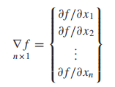
Gradient of a Function
The gradient of a function in an n-component vector is given by
The gradient has a very important property. If we move along the gradient direction from any point in n-dimensional space, the function value increases at the fastest rate.
Hence the gradient direction is called the direction of steepest ascent.

Slide 6
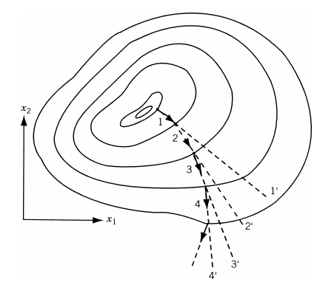
Unfortunately, the direction of steepest ascent is a local property and not a global one. This is illustrated in below figure, where the gradient vectors ∇f evaluated at points 1, 2, 3, and 4 lie along the directions 11′ , 22′ , 33′ , and 44′ , respectively. Thus the function value increases at the fastest rate in the direction 11′ at point 1, but not at point 2.

Slide 7
Since the gradient vector represents the direction of steepest ascent, the negative of the gradient vector denotes the direction of steepest descent. Thus any method that makes use of the gradient vector can be expected to give the minimum point faster than one that does not make use of the gradient vector. All the descent methods make
use of the gradient vector, either directly or indirectly, in finding the search directions.

Slide 8
Steepest Descent (Cauchy) Method
The use of the negative of the gradient vector as a direction for minimization was first made by Cauchy in 1847. In this method we start from an initial trial point X1 and iteratively move along the steepest descent directions until the optimum
point is found. The steepest descent method can be summarized by the following steps:
1. Start with an arbitrary initial point X1. Set the iteration number as i = 1.
2. Find the search direction Si as
S_{i} = −∇f_{i} = −∇f (X_{i})
3. Determine the optimal step length λ∗i in the direction Si and set
X_{i+1} = X_{i} + λ_{i}∗ S_{i} = X_{i} − λ_{i}∗ ∇f_{i}
4. Test the new point, Xi+1, for optimality. If X_{i+1} is optimum, stop the process.
Otherwise, go to step 5.
5. Set the new iteration number i = i + 1 and go to step 2.

Slide 9
Example Problem:
Minimize f(x₁,x₂)=x₁-x₂+2x₁²+2x₁x₂+x₂² starting from the point x₁=(0,0)

Slide 10
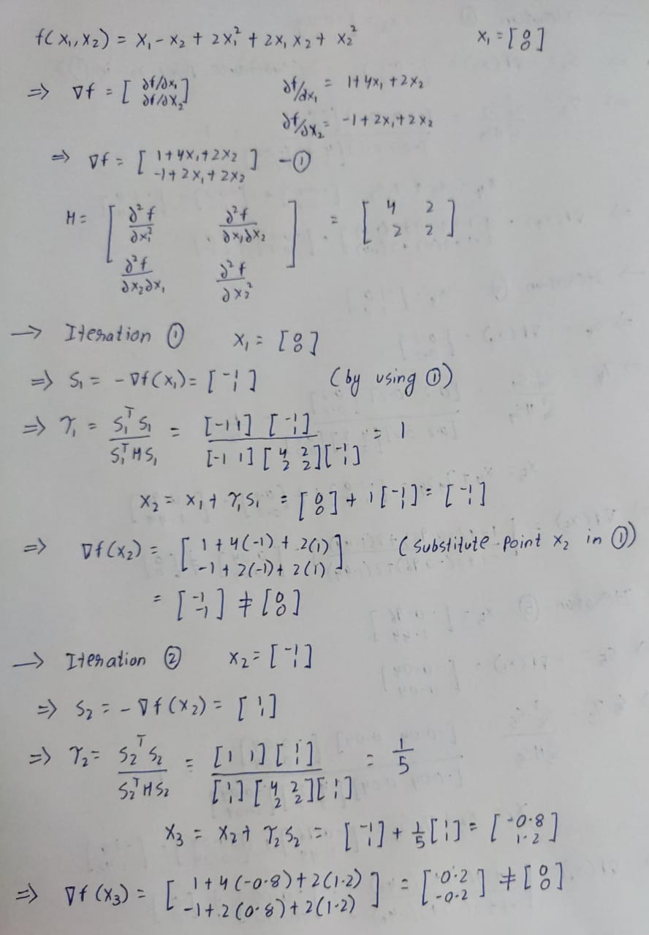

Slide 11
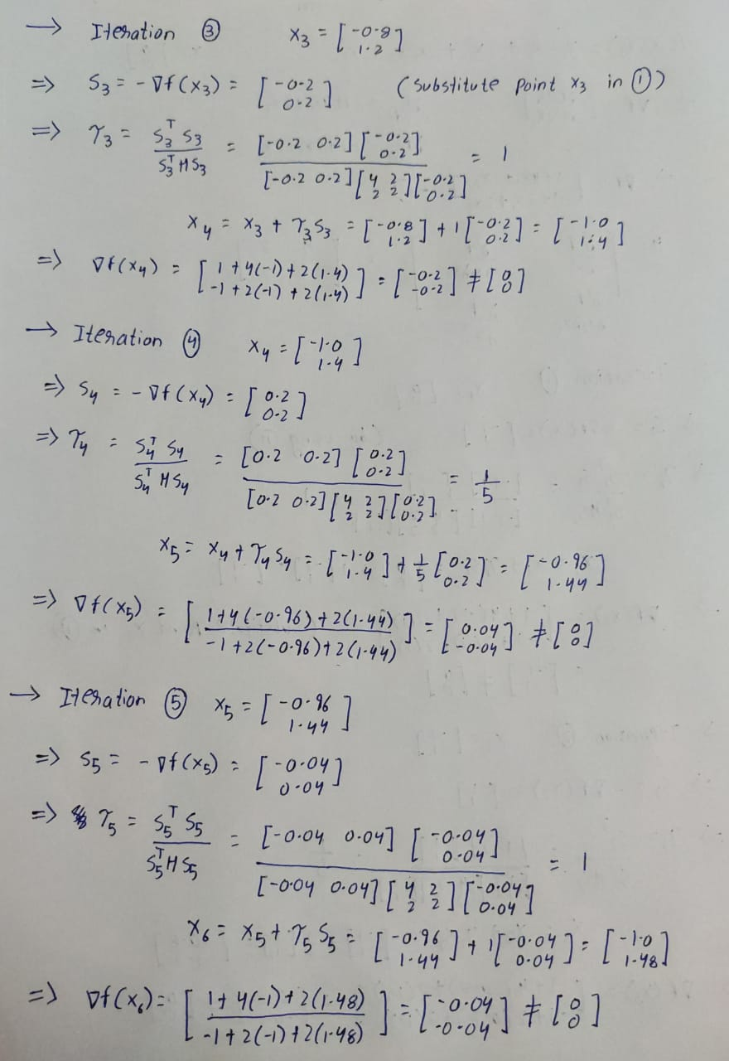

Slide 12
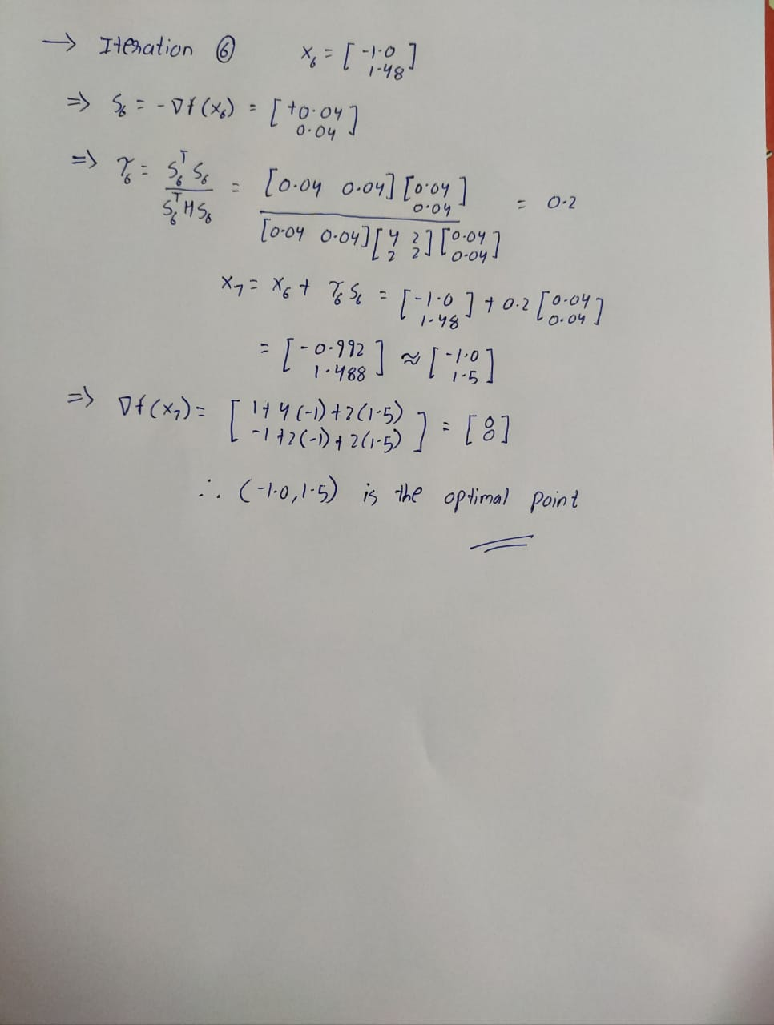

Slide 13
ANY QUESTIONS ??
THANK YOU !!!

